Slide 1

Internships-2020
@
Applied Courses
interviewprep.appliedcourse.com

Slide 2
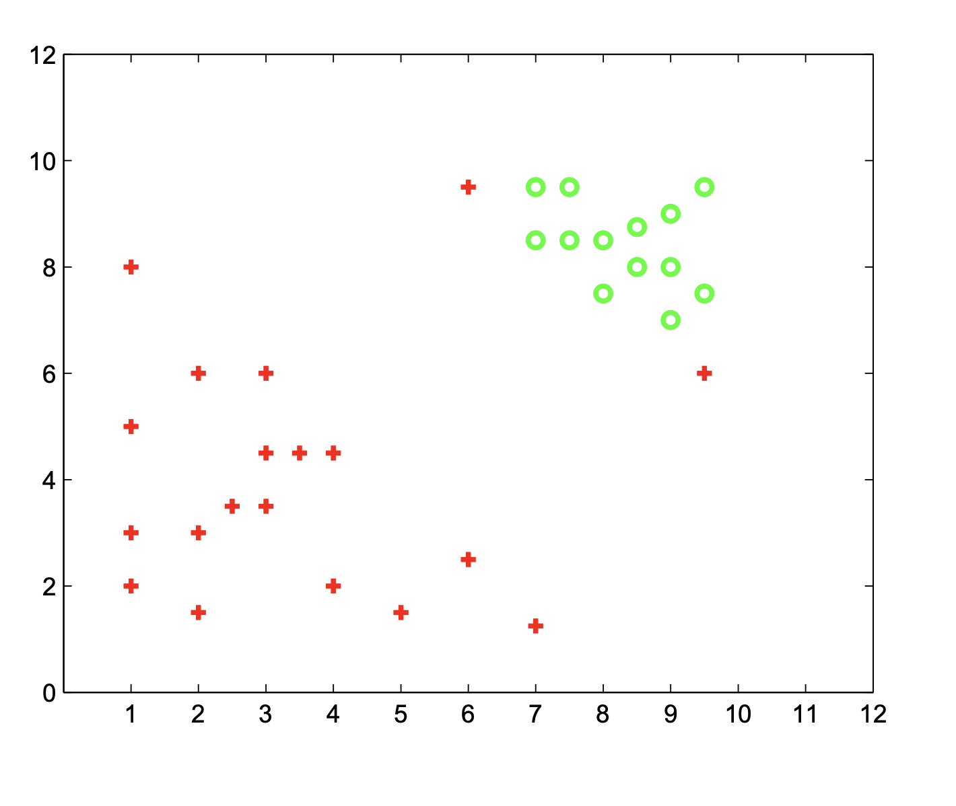
Where would the decision boundary be for very large values of C (i.e., C → ∞)? if we are using an SVM with a quadratic kernel.)

Slide 3
For C ≈ 0, indicate in the figure below, where you would expect the decision boundary to be? Justify your answer

Slide 4
Which is better? C ~ 0 or
C---> INFINITY, if we have to pick one of them?

Slide 5
Which is better? C ~ 0 or
C---> INFINITY, if we have to pick one of them?

Slide 6
Draw a data point which will not change the decision boundary learned for very large values of C.

Slide 7
Why does the kernel trick allow us to solve SVMs with high dimensional feature spaces, without significantly increasing the running time?

Slide 8
Consider a point that is correctly classified and distant from the decision boundary. Why would SVM’s decision boundary be unaffected by this point, but the one learned by logistic regression be affected?

Slide 9
SVMs tend to be robust to irrelevant features. Suppose we run SVMs with features X1, . . . , Xn, and then add a irrelevant feature Xn+1 that cannot help increase the margin. How will SVMs automatically ignore this feature?

Slide 10
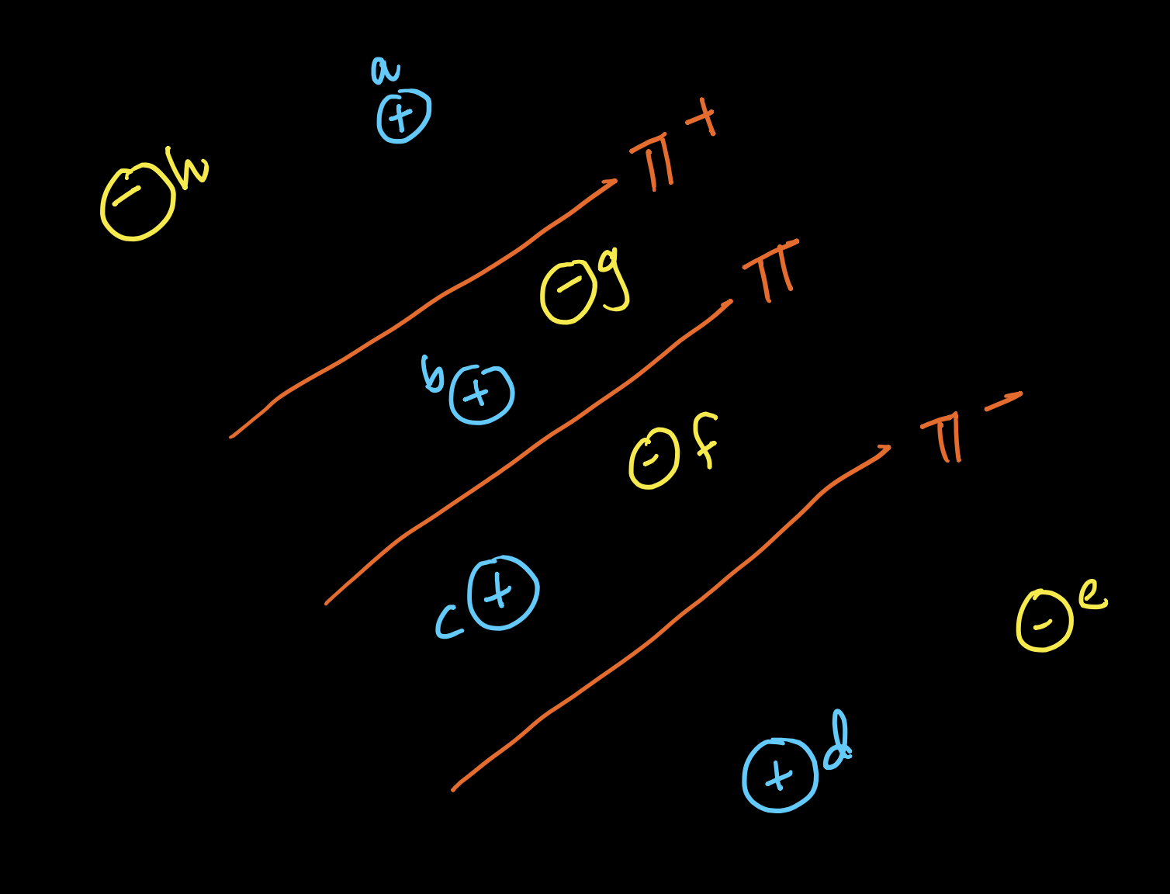
Which of these points have zeta_i (slack) >0

Slide 11
Which of these points are Support Vectors?

Slide 12
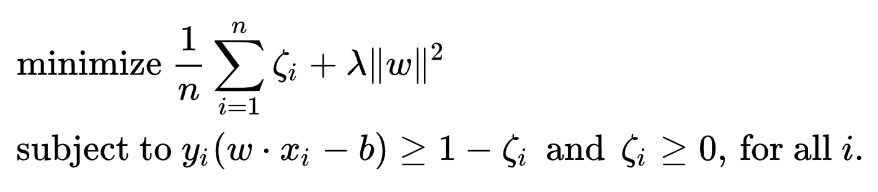
In the SVM primal formulation, is ||W||=1 ?

Slide 13
Why do we need the dual? Why can't we simply use SGD and solve the primal?

Slide 14
Why do we need the dual? Why can't we simply use SGD and solve the primal?

Slide 15
How do we compute the class label and probabilistic class label after solving the dual-SVM?

Slide 16
When should you prefer Logistic Regression over SVMs?

Slide 17
When does RBF-Kernel SVM start behaving somewhat similar to a Nearest Neighbor and why?

Slide 18
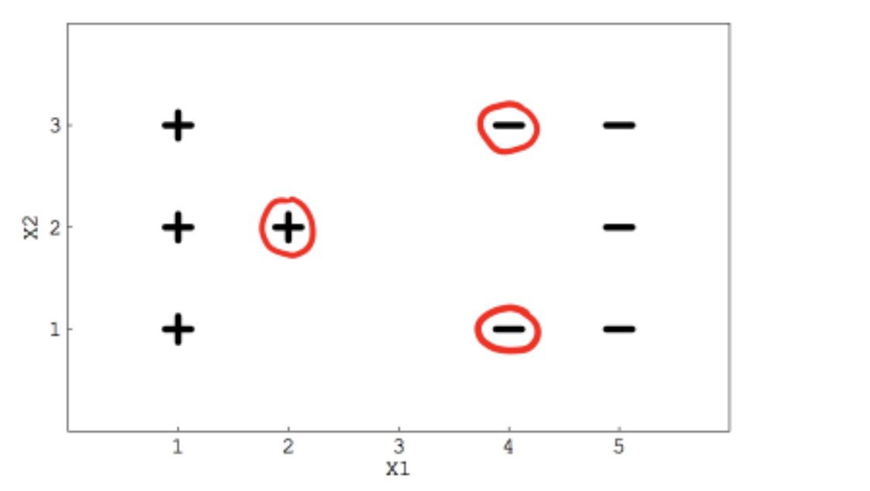
If you remove the following any one red points from the data. Does the decision boundary will change?

Slide 19
If you remove the following any one red points from the data. Does the decision boundary will change?

Slide 20
The effectiveness of an SVM depends upon:
A) Selection of Kernel
B) Kernel Parameters
C) Selection of the optimizer (SGD vs SMO)
D) Soft Margin Parameter C

Slide 21
The effectiveness of an SVM depends upon:
A) Selection of Kernel
B) Kernel Parameters
C) Selection of the optimizer (SGD vs SMO)
D) Soft Margin Parameter C

Slide 22
Suppose you have trained an SVM with linear decision boundary after training SVM, you correctly infer that your SVM model is under fitting.
Which of the following option would you more likely to consider iterating SVM next time?
A) You want to increase your data points
B) You want to decrease your data points
C) You will try to calculate more variables/features
D) You will try to reduce the features

Slide 23
In above question, after adding new features suppose you want to change one of it’s(SVM) hyperparameter so as not to underfit?
A) We will increase the parameter C
B) We will decrease the parameter C
C) Changing in C don’t effect
D) None of these

Slide 24
Why is Kernel-Logistic Regression NOT as popular as SVMs?

Slide 25
How would you reduce the run-time complexity of SVMs for low-latency applications?

Slide 26
When does a Logistic regression model differ from a Linear SVM?

Slide 27
In which applications did you observe SVMs perform better than other methods like LR, RF, GBDT etc.

Slide 28
Primal ---> Dual
How does SMO work?

